Slide 1
Unicorn Startups Analysis
Nnete Monageng

Slide 2
Introduction
In this presentation, we will embark on a journey through the captivating world of Unicorn startups – those exceptional companies that have achieved a valuation of $1 billion or more. Our mission is to uncover the secrets to their success, decode their strategies, and provide valuable insights and recommendations.
As we delve into the data, we'll unveil a tapestry of remarkable trends and stories. From technology dominance to global expansion, each insight is a piece of the puzzle that forms the Unicorn landscape.
Our analysis goes beyond the numbers; it's a roadmap for entrepreneurs, investors, and business leaders seeking to thrive in the dynamic realm of startups.
So, fasten your seatbelts as we embark on this journey through the Unicorn Startups Analysis, where each slide holds a revelation, and each insight is a key to unlocking a world of possibilities.

Slide 3
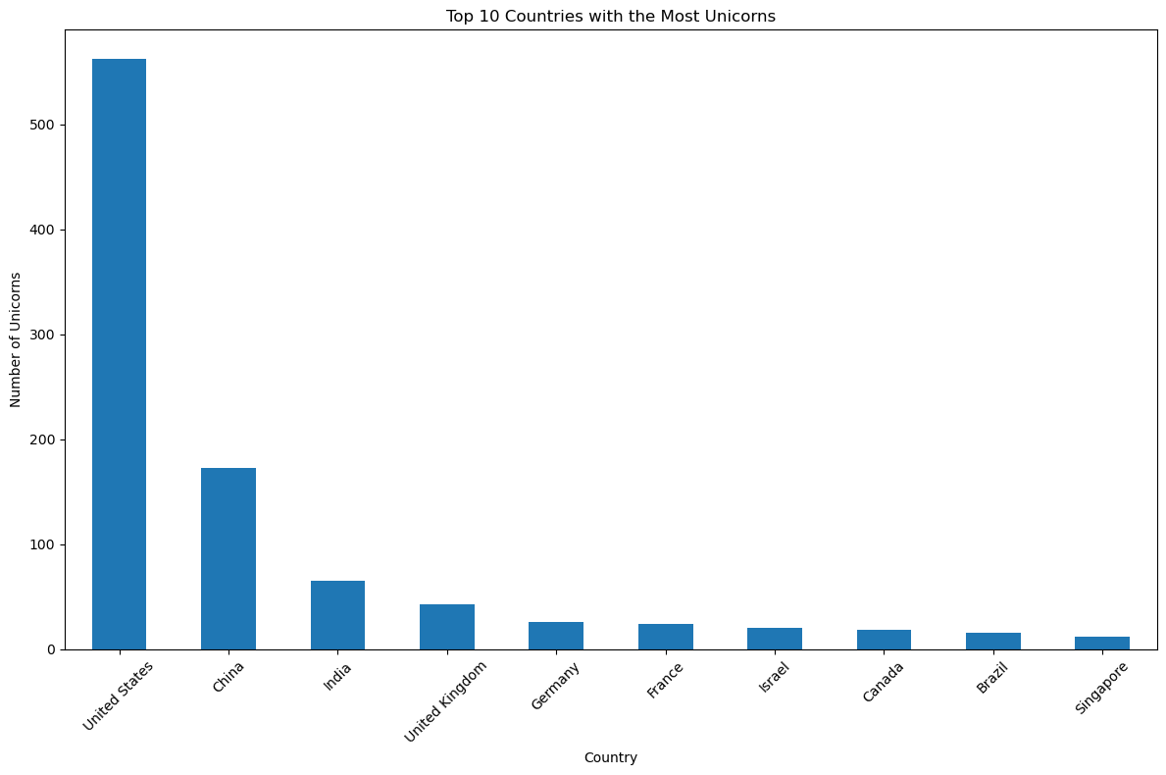
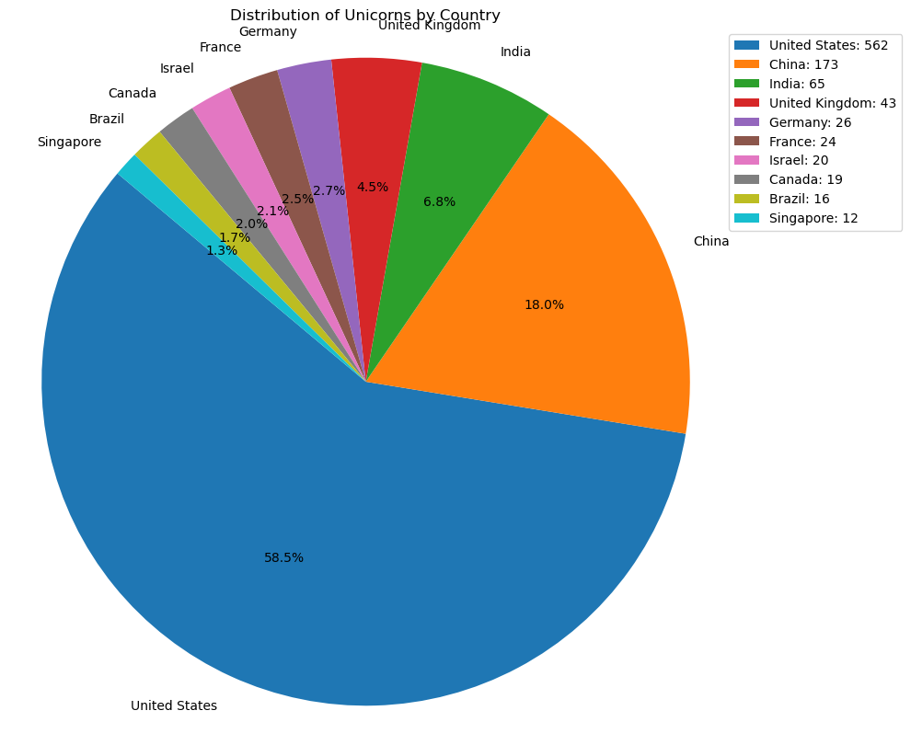
COUNTRIES WITH THE MOST UNICORNS
It's evident that the United States and China dominate the unicorn landscape, with a substantial concentration of startups.
This diverse distribution underscores the international nature of venture capital investment in startups.

Slide 4
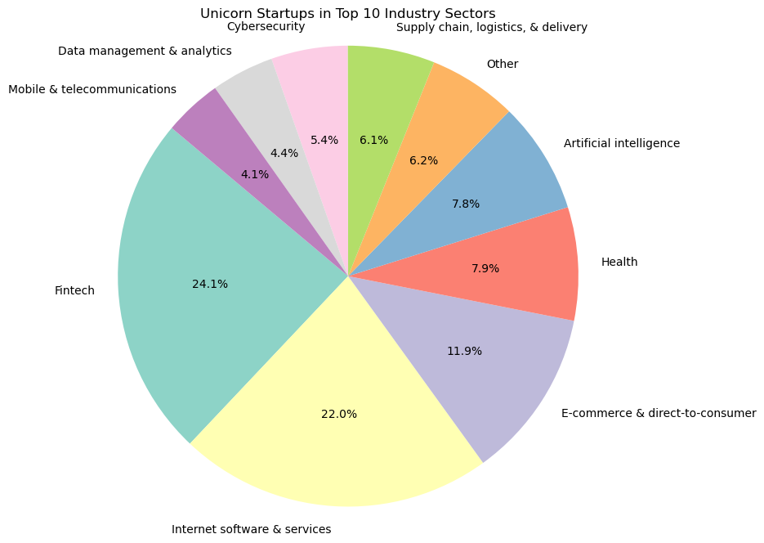
Top 10 Unicorn startups industry sectors
Leading the pack is the dynamic field of Fintech, marked by its disruptive financial technologies and services.
Following closely is Internet Software & Services, driving innovation in digital solutions and platforms.
Beyond fintech and internet software & services, the unicorn landscape boasts a rich diversity of sectors

Slide 5
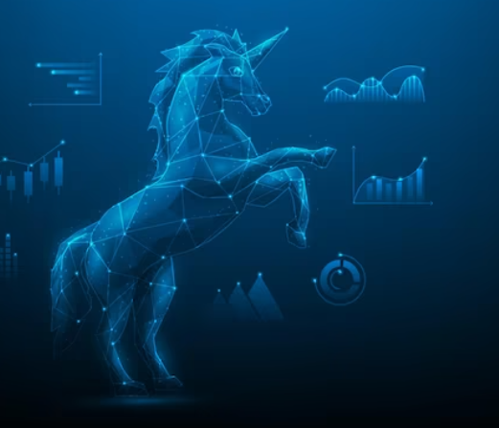
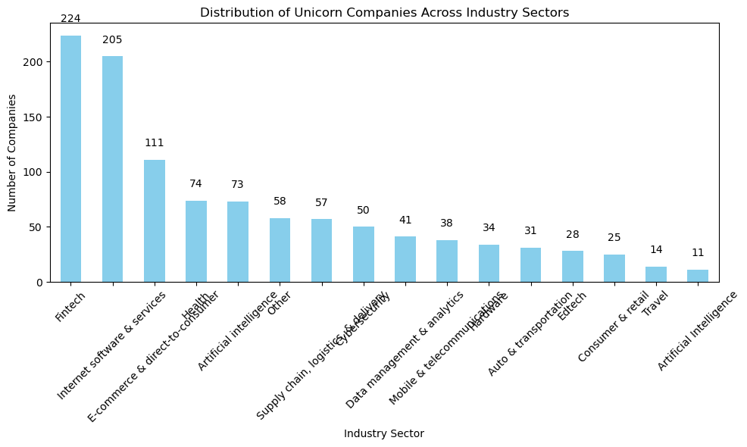
Technology dominance
The dataset predominantly consists of companies in the technology sector, indicating a strong focus on innovation and disruptive technologies.

Slide 6
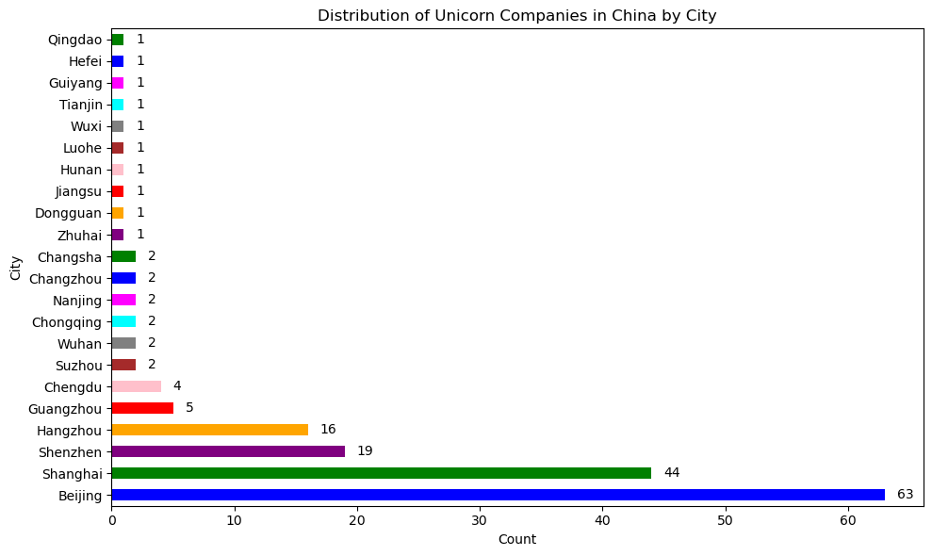
China's Rise
China stands out as a leading country with a significant number of unicorn companies, showcasing the growth of its startup ecosystem and venture capital investment.

Slide 7
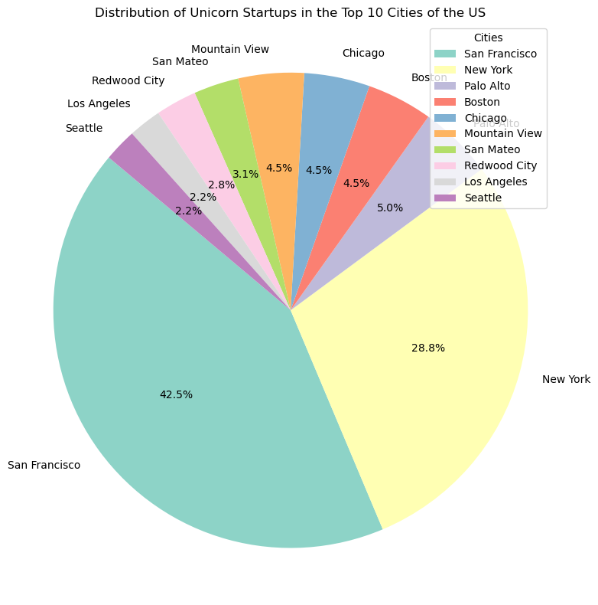
US City Concentration
Among the cities, San Francisco, CA in the United States has the highest number of unicorn startups, emphasizing its status as a global tech hub.

Slide 8
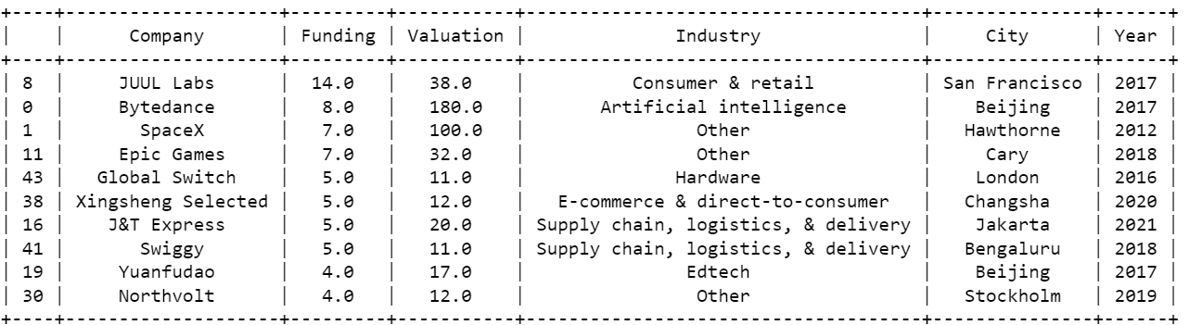
Funding Pattern
The majority of unicorn companies have received funding in the billions range, signifying the substantial investment interest in these high-potential startups

